Slide 1
Flight Price Prediction
Presented by-
Ashwini Sidnale

Slide 2
Part I Introduction
In this article, we will be analyzing the flight fare prediction using essential exploratory data analysis techniques then will draw some predictions about the price of the flight based on some features such as what type of airline it is, what is the arrival time, what is the departure time, what is the duration of the flight, source, destination and more.

Slide 3
About the dataset
Airline: So this column will have all the types of airlines like Indigo, Jet Airways, Air India, and many more.
Date_of_Journey: This column will let us know about the date on which the passenger’s journey will start.
Source: This column holds the name of the place from where the passenger’s journey will start.
Destination: This column holds the name of the place to where passengers wanted to travel.
Route: Here we can know about that what is the route through which passengers have opted to travel from his/her source to their destination.
Arrival_Time: Arrival time is when the passenger will reach his/her destination.
Duration: Duration is the whole period that a flight will take to complete its journey from source to destination.
Total_Stops: This will let us know in how many places flights will stop there for the flight in the whole journey.
Additional_Info: In this column, we will get information about food, kind of food, and other amenities.
Price: Price of the flight for a complete journey including all the expenses before onboarding.

Slide 4
Dataset Details
Kaggle link : https://www.kaggle.com/datasets/nikhilmittal/flight-fare-prediction-mh
10683 rows, 11 columns

Slide 5
Part-II Data Pre-processing and Data Cleaning
Data preprocessing is the process of transforming raw data into an understandable format. It is also an important step in data mining as we cannot work with raw data. The quality of the data should be checked before applying machine learning or data mining algorithms.
Load data in Pandas.
Drop columns that aren't useful.
Drop rows with missing values.
Create dummy variables.
Take care of missing data.
Convert the Data Frame to NumPy.
Divide the data set into training data and test data.

Slide 6
Finding null values:
Missing Data can occur when no information is provided for one or more items or for a whole unit.
In order to check missing values in Pandas Data Frame, we use a function isnull() and notnull()

Slide 7
Date of Journey, Departure Time, Arrival Time, Duration these are a object data type . Therefore, we have to convert this data type into timestamp so as to use this column properly for prediction
So after adding new columns and dropping these four columns our train data having shape(10682, 30)

Slide 8
Part III Feature Engineering : One hot encoding , Label encoding
Feature Engineering is the process of extracting and organizing the important features from raw data in such a way that it fits the purpose of the machine learning model.
One hot Encoder is used in when data is not in any order (nominal data)
Is Label encoder is used when data is in order (Ordinal data )
Handling Categorical values Airline, Source, Destination, Total_Stops

Slide 9
Part IV : statistical description, Plotting, Correlation, Check for
assumptions for applying Regression
Statistical description of dataset :
Assumptions To apply Regression Technique:
Linearity : By Plotting Scatter plot (regression)
Normality : By Plotting distribution plots
Multicollinearity : By finding correlation
Check for Outliers - If linear regression can be applied

Slide 10
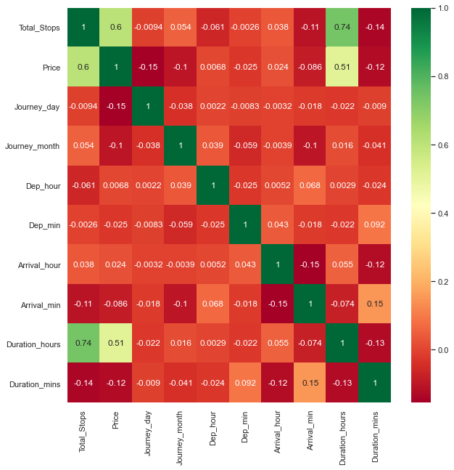
correlation between Independent and dependent attributes

Slide 11
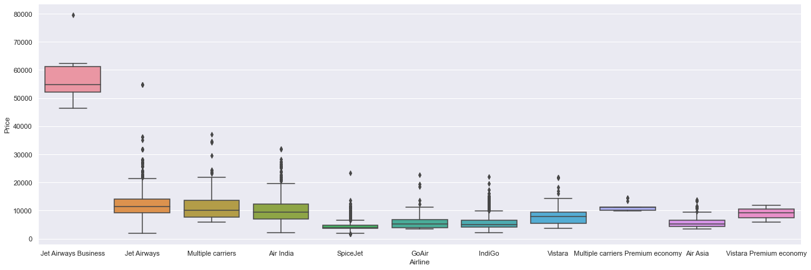
Airline vs Price Plot

Slide 12
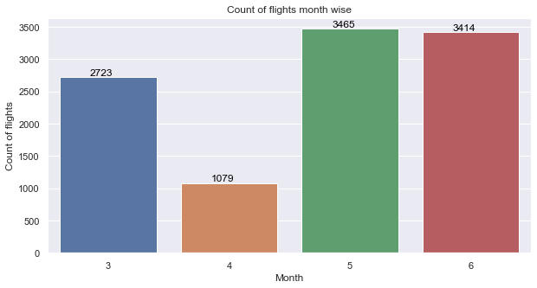
Month wise count of Flights

Slide 13
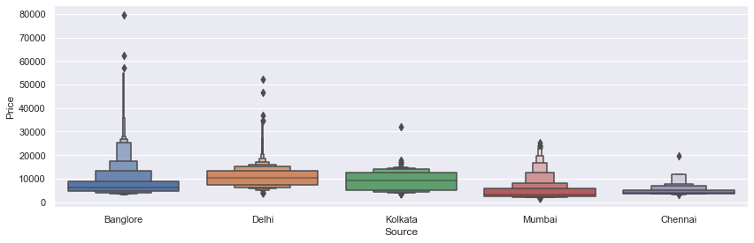
Source vs Price

Slide 14
Part V : Applying Model on training and Testing dataset, Finding Prediction On Unseen data
Feature Selection - Raw data used for training generates low efficiency model, So to achieve objective of Problem we remove noise, less important features. We select optimal features.
Feature selection techniques
Extra Tree Regressor , Ensemble Technique
Fitting Model
Check MAE, MSE, RMSE
Good value of RMSE

Slide 15
Hyper-parameter Tuning
A Machine Learning model is defined as a mathematical model with a number of parameters that need to be learned from the data. By training a model with existing data, we are able to fit the model parameters.
However, there is another kind of parameter, known as Hyperparameters, that cannot be directly learned from the regular training process. They are usually fixed before the actual training process begins. These parameters express important properties of the model such as its complexity or how fast it should learn.
Some examples of model hyperparameters include:
The penalty in Logistic Regression Classifier i.e. L1 or L2 regularization
The learning rate for training a neural network.
The C and sigma hyperparameters for support vector machines.
The k in k-nearest neighbors.

Slide 16
Conclusion
This can assist airlines in determining what rates they can keep.
From this project I conclude that depends on the journey time ,journey month,total stops,journey hour,route price will change.

